Slide 1
Lung Cancer Analysis
Resume Project Challenge
Jericho Joshua Lomibao
Tools Used: MySQL, Excel and Power Bi

Slide 2
Goal of Analysis for Lung Cancer Dataset
The primary goal of this analysis is to investigate the factors contributing to lung cancer incidence, progression, and outcomes. This includes identifying key risk factors such as smoking, environmental exposures, genetic predispositions, and lifestyle influences. The analysis will also focus on early detection methods, treatment effectiveness, survival rates, and disparities in healthcare access. By leveraging statistical models and data-driven insights, this study aims to improve early diagnosis, optimize treatment strategies, and inform public health policies for better prevention and management of lung cancer.
Project Objective
The objective of this project is to analyze key factors influencing lung cancer incidence, progression, and patient outcomes. By examining smoking habits, environmental exposures, genetic predispositions, and lifestyle factors, the study aims to identify critical risk elements. Additionally, the project evaluates early detection methods, treatment effectiveness, survival rates, and healthcare disparities. Using statistical models and data-driven insights, the findings will contribute to enhancing early diagnosis, optimizing treatment strategies, and shaping informed public health policies for better lung cancer prevention and management.

Slide 3
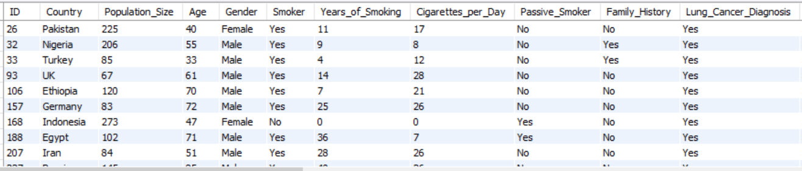

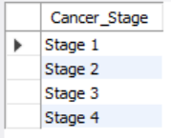


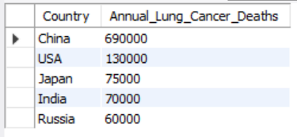
------ Beginner Level
Retrieve all records for individuals diagnosed with lung cancer.
SELECT *
FROM lung_cancer_data1
WHERE Lung_Cancer_Diagnosis = 'Yes';
2. Count the number of smokers and non-smokers.
SELECT
SUM(CASE WHEN Smoker LIKE 'Yes' THEN 1 ELSE 0 END) AS Smokers,
SUM(CASE WHEN Smoker LIKE 'No' THEN 1 ELSE 0 END) AS `Non Smoker`
FROM lung_cancer_data1;
3. List all unique cancer stages present in the dataset.
SELECT DISTINCT Cancer_Stage
FROM lung_cancer_data1
WHERE Cancer_Stage != 'None';
4. Retrieve the average number of cigarettes smoked per day by smokers.
SELECT AVG(Cigarettes_per_Day) AS `Average Cigarette Per Day`
FROM lung_cancer_data1;
5. Count the number of people exposed to high air pollution.
SELECT COUNT(Population_Size) AS `High Exposed`, Air_Pollution_Exposure
FROM lung_cancer_data1
WHERE Air_Pollution_Exposure LIKE 'High’
GROUP BY Air_Pollution_Exposure;
6. Find the top 5 countries with the highest lung cancer deaths.
SELECT DISTINCT Country, Annual_Lung_Cancer_Deaths
FROM lung_cancer_data1WHERE Lung_Cancer_Diagnosis LIKE 'Yes’
ORDER BY Annual_Lung_Cancer_Deaths DESC
LIMIT 5;

Slide 4

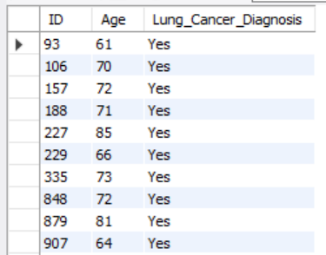

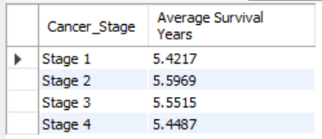
7. Count the number of people diagnosed with lung cancer by gender.
SELECT Gender, COUNT(Lung_Cancer_Diagnosis) AS Counts
FROM lung_cancer_data1
WHERE Lung_Cancer_Diagnosis LIKE ‘Yes
'GROUP BY Gender, Lung_Cancer_Diagnosis;
8. Retrieve records of individuals older than 60 who are diagnosed with lung cancer.
SELECT ID, Age, Lung_Cancer_Diagnosis
FROM lung_cancer_data1
WHERE Age > 60
AND Lung_Cancer_Diagnosis LIKE 'Yes';
------ Intermediate Level
Find the percentage of smokers who developed lung cancer.
SELECT ROUND(
(COUNT(CASE WHEN Smoker = 'Yes' THEN 1
WHEN Lung_Cancer_Diagnosis = 'Yes' THEN 1 END) * 100.0 / COUNT(*)), 2) AS `% of Smoker with Lung Cancer`
FROM lung_cancer_data1;
SELECT *
FROM lung_cancer_data1;
2. Calculate the average survival years based on cancer stages.
SELECT Cancer_Stage, AVG(Survival_Years) `Average Survival Years`
FROM lung_cancer_data1
WHERE Cancer_Stage != 'None’
GROUP BY Cancer_Stage
ORDER BY Cancer_Stage ASC;

Slide 5

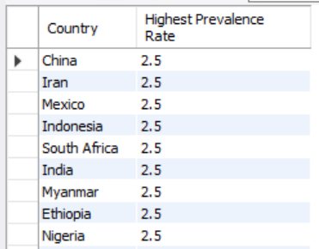
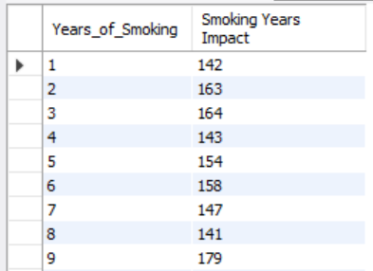
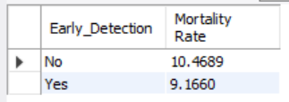
3. Count the number of lung cancer patients based on passive smoking.
SELECT Passive_Smoker, COUNT(Lung_Cancer_Diagnosis)
AS `Passive Smoker Who Developed Lung Cancer`
FROM lung_cancer_data1
WHERE Passive_Smoker = 'Yes';
4. Find the country with the highest lung cancer prevalence rate.
SELECT Country, MAX(Lung_Cancer_Prevalence_Rate) AS `Highest Prevalence Rate`
FROM lung_cancer_data1
GROUP BY Country
ORDER BY `Highest Prevalence Rate` DESC;
5. Identify the smoking years impact on lung cancer.
SELECT Years_of_Smoking, COUNT(*) AS `Smoking Years Impact`
FROM lung_cancer_data1
WHERE Lung_Cancer_Diagnosis = 'Yes’
AND Years_of_Smoking != 0
GROUP BY Years_of_Smoking
ORDER BY Years_of_Smoking ASC;
6. Determine the mortality rate for patients with and without early detection.
SELECT Early_Detection, COUNT(*) AS `Total Patients`,
SUM(CASE WHEN Mortality_Rate = 'Yes' THEN 1 ELSE 0 END) AS `Deceased`, (SUM(CASE WHEN Mortality_Rate = 'Yes' THEN 1 ELSE 0 END) * 100.0/COUNT(*)) AS `Rate`
FROM lung_cancer_data1
GROUP BY Early_Detection;SELECT Early_Detection, COUNT(CASE WHEN Lung_Cancer_Diagnosis = 'Yes' AND Survival_Years = 1 THEN 1 END) * 100 /COUNT(CASE WHEN Lung_Cancer_Diagnosis = 'Yes' THEN 1 END) AS `Mortality Rate`
FROM lung_cancer_data1
GROUP BY Early_Detection;

Slide 6
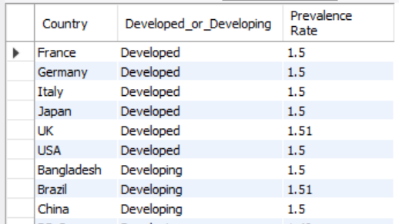
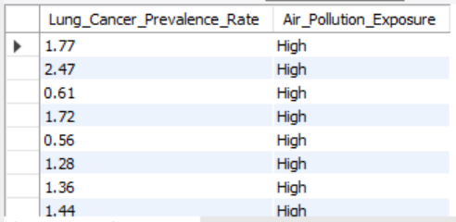
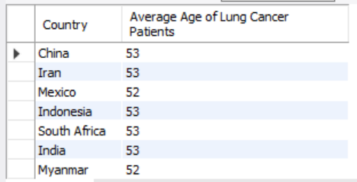
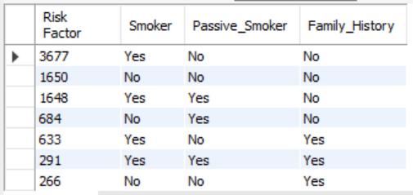
7. Group the lung cancer prevalence rate by developed vs. developing countries.
SELECT Country, Developed_or_Developing, ROUND(AVG(Lung_Cancer_Prevalence_Rate), 2) AS `Prevalence Rate
`FROM lung_cancer_data1
GROUP BY Developed_or_Developing, Country
ORDER BY Developed_or_Developing;
------ Advanced Level
1. Identify the correlation between lung cancer prevalence and air pollution levels.
SELECT Air_Pollution_Exposure, ROUND(AVG(Lung_Cancer_Prevalence_Rate), 5) AS `Average Prevalence`
FROM lung_cancer_data1
GROUP BY Air_Pollution_Exposure
ORDER BY Air_Pollution_Exposure;
2. Find the average age of lung cancer patients for each country.
SELECT DISTINCT Country, ROUND(AVG(Age)) AS `Average Age of Lung Cancer Patients`
FROM lung_cancer_data1
GROUP BY Country;
3. Calculate the risk factor of lung cancer by smoker status, passive smoking, and family history
.SELECT COUNT(*) AS `Risk Factor`, Smoker, Passive_Smoker, Family_History
FROM lung_cancer_data1
WHERE Lung_Cancer_Diagnosis = 'Yes’
GROUP BY Smoker, Passive_Smoker, Family_History
ORDER BY `Risk Factor` DESC;

Slide 7
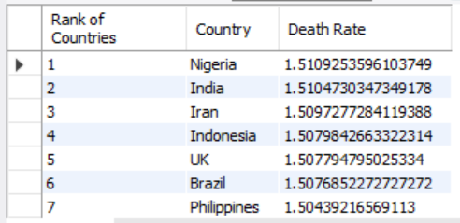
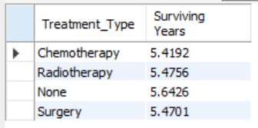
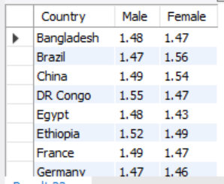
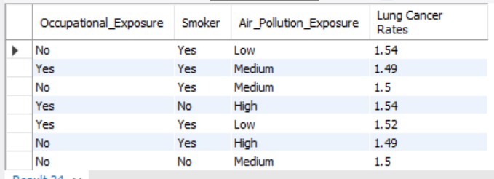
4. Rank countries based on their mortality rate
WITH MortalityByCountry AS
(SELECT Country,
SUM(CASE WHEN Lung_Cancer_Diagnosis = 'Yes' THEN 1 ELSE 0 END), ROUND(SUM(Lung_Cancer_Prevalence_Rate), 2) / COUNT(*) AS `Death Rate` FROM lung_cancer_data1
GROUP BY Country)
SELECT
RANK() OVER(ORDER BY `Death Rate` DESC) AS `Rank of Countries`, Country, `Death Rate`
FROM MortalityByCountry;
5. Determine if treatment type has a significant impact on survival years.
SELECT Treatment_Type, AVG(Survival_Years) AS `Surviving Years`
FROM lung_cancer_data1
WHERE Lung_Cancer_Diagnosis = 'Yes’
GROUP BY Treatment_Type;
6. Compare lung cancer prevalence in men vs. women across countries.
SELECT Country, ROUND(AVG
(CASE WHEN Gender LIKE 'Male' THEN Lung_Cancer_Prevalence_Rate END), 2) AS Male,
ROUND(AVG(CASE WHEN Gender LIKE 'Female' THEN Lung_Cancer_Prevalence_Rate END), 2) AS Female
FROM lung_cancer_data1
WHERE Lung_Cancer_Diagnosis = 'Yes’
GROUP BY CountryORDER BY Country;
7. Find how occupational exposure, smoking, and air pollution collectively impact lung cancer rates.
SELECT Occupational_Exposure, Smoker, Air_Pollution_Exposure, ROUND(AVG(Lung_Cancer_Prevalence_Rate), 2) AS `Lung Cancer Rates`
FROM lung_cancer_data1
WHERE Lung_Cancer_Diagnosis = 'Yes’
GROUP BY Occupational_Exposure, Smoker, Air_Pollution_Exposure;

Slide 8
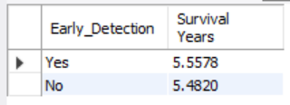
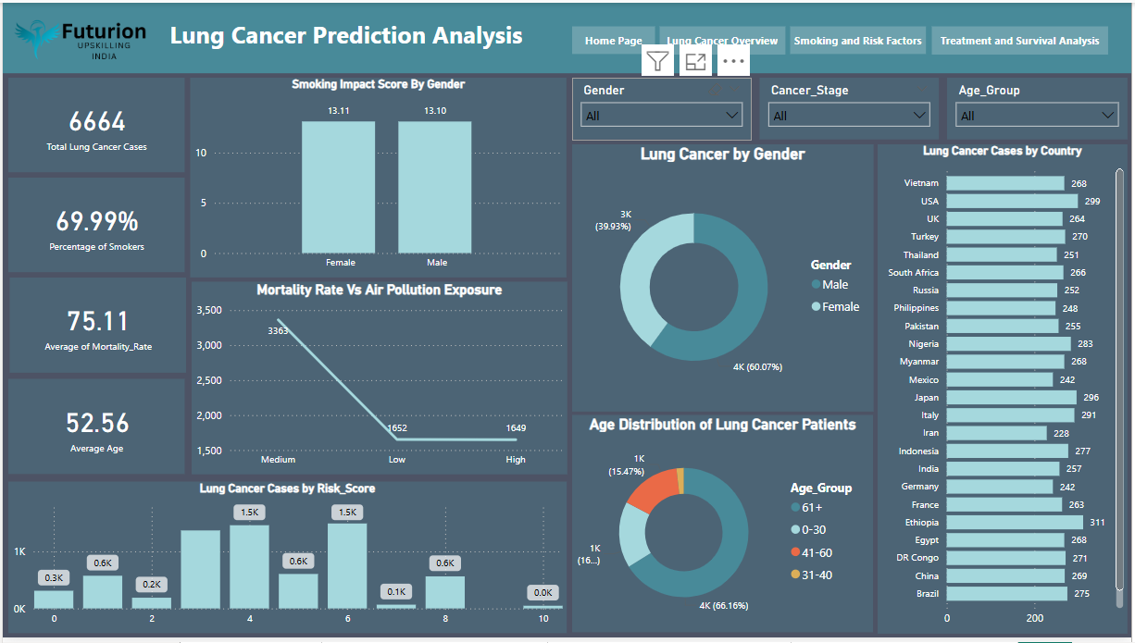
8. Analyze the impact of early detection on survival years.
SELECT Early_Detection, AVG(Survival_Years) AS `Survival Years`
FROM lung_cancer_data1
WHERE Lung_Cancer_Diagnosis = 'Yes’
GROUP BY Early_Detection
ORDER BY `Survival Years` DESC;
Lung Cancer Overview
Key Insights: Lung Cancer Cases By Country
Illustrates the distribution and prevalence of lung cancer across different regions.
Lung Cancer Cases By Gender
Displays the gender-based distribution of cancer cases.
Age Distribution of Lung Cancer Patients
Categorizes age ranges to enhance data analysis.
Smoking Impact Score by Gender
Analyzes smoking severity differences between genders.
Mortality Rate vs. Air Pollution Exposure
Evaluates the influence of environmental factors on lung cancer mortality rates.
Lung Cancer Risk Score Distribution
Refines data selection to facilitate in-depth analysis.

Slide 9
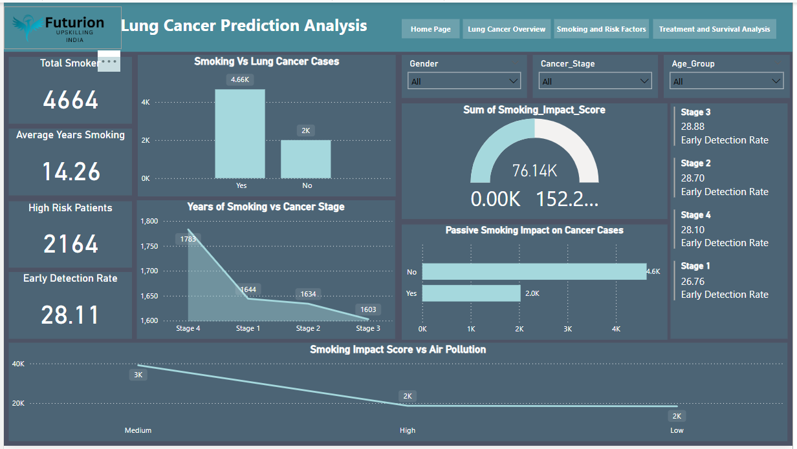
Smoking and Risk Factors
Key Insights: Smoking vs Lung Cancer Cases
Examines the correlation between smoking status (Smoker vs. Non-Smoker) and lung cancer diagnosis.
Years of Smoking vs Cancer Stage
Analyzes whether a longer smoking duration correlates with more severe cancer stages.
Passive Smoking Impact on Cancer Cases
Compares lung cancer cases among individuals exposed and not exposed to passive smoking.
Lung Cancer Diagnosis by Smoking Impact Score Compares lung cancer cases among individuals exposed and not exposed to passive smoking.
Smoking and Air Pollution Exposure Relationship Determines if high air pollution levels and smoking together increase lung cancer prevalence.
Survival years over gender.
There is a notable difference in survival years between genders, suggesting potential biological, lifestyle, or treatment-related factors influencing lung cancer outcomes.

Slide 10
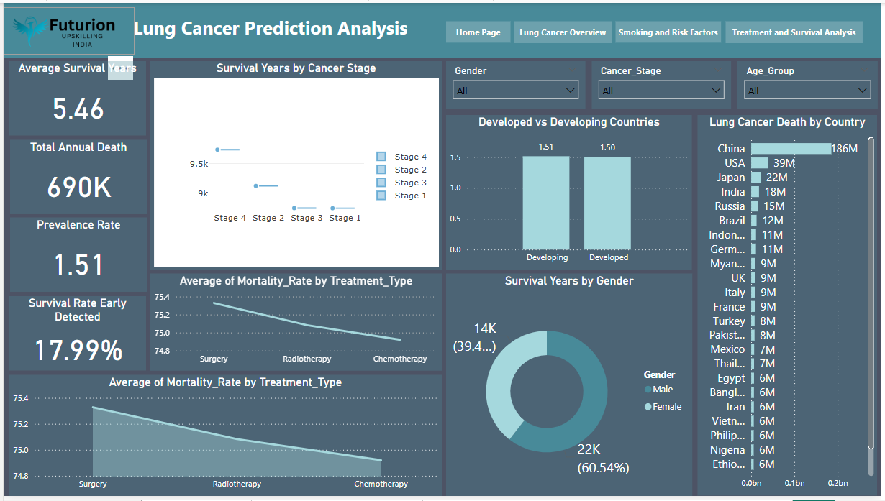
Treatment and Survival Analysis
Key Insights: Survival Years by Treatment Type
Different treatment types show varying impacts on survival years, with early and targeted interventions generally leading to longer survival rates. Personalized treatment strategies can significantly improve patient outcomes.
Lung Cancer Deaths by Country
To illustrate variations in lung cancer mortality rates among different countries.
Developed vs. Developing Countries: Cancer Prevalence
To analyze the differences in lung cancer prevalence rates between developed and developing nations.
Mortality Rate vs. Treatment Type
To examine the variation in survival years across different stages of lung cancer.
Survival Rate Distribution by Cancer Stage Survival rates decrease significantly as cancer stage progresses, highlighting the importance of early detection and intervention.
Early Detection Rate vs. Cancer Stage
Higher early detection rates are associated with lower cancer stages at diagnosis, emphasizing the importance of screening programs in improving patient outcomes.

Slide 11
Conclusion and Recommendations
Conclusion:
The analysis of lung cancer treatment and survival patterns reveals that survival outcomes are significantly influenced by treatment type, cancer stage, and demographic factors. Early detection plays a crucial role in improving survival rates, as patients diagnosed at earlier stages tend to have better outcomes. Additionally, disparities in lung cancer mortality rates between developed and developing countries suggest differences in healthcare access, screening programs, and lifestyle factors. Personalized treatment strategies and improved healthcare interventions can enhance survival rates and reduce lung cancer-related deaths worldwide.
Recommendations:
Strengthen Early Detection Programs:
Implement nationwide lung cancer screening initiatives, particularly for high-risk populations. Increase public awareness campaigns on early signs and risk factors.
Enhance Access to Quality Treatment:
Improve the availability of advanced treatment options such as targeted therapies and immunotherapy. Develop policies that make lung cancer treatment more affordable and accessible.
Address Global Disparities in Cancer Care:
Invest in healthcare infrastructure in developing countries to improve diagnosis and treatment availability. Foster international collaboration for knowledge sharing and best practices in lung cancer treatment.
Encourage Smoking Cessation and Risk Reduction:
Strengthen tobacco control policies and smoking cessation programs. Promote environmental initiatives to reduce exposure to air pollution and carcinogens.
Continue Research and Data Analysis:
Conduct further studies on gender-based and regional differences in lung cancer survival rates. Utilize predictive analytics and machine learning to improve early detection and personalized treatment planning.

